Slide 1
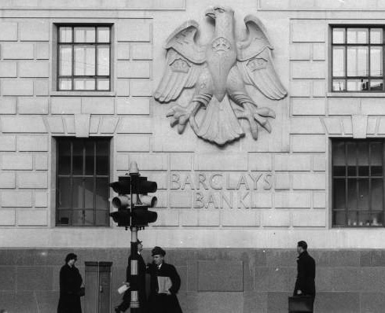

Welcome, rookie!
May 16, 2023

Slide 2







Agenda
Intro
Onboarding
Solving Case 1 – The missing book!
Break
Solving Case 2 – Election fraud?
Possibly more (TBD)
Notes:
Realistically we probably won't make it past case 2.

Slide 3

Kusto Detective Agency Video

Slide 4
Rules of the game
Work together! It’s more fun to share your progress and ask for help.
There are a total of five cases to solve.
A digital badge is given to every player who correctly solves a case.
All previous cases will remain active for play even after the new cases are published.
Please see section 6 in the “Terms and Conditions” for more details.

Slide 5

Observational Analytics
Frequently changing business questions
Constantly changing schema
Near real time visibility required
Why is it challenging to analyze?
Analytics systems costs are often prohibitive
Looking for unpredictable phenomena
Notes:
What makes observational analytics special?
Velocity of the business environment is accelerating. We have the information flowing in and we are expected to use it to constantly improve how we operate
The data keeps changing, with new types and versions of devices and apps, changing vendors and business partners, and evolution of the information needs that drives deeper data collection.
A lot is encoded in text or json (Semi/unstructured)
ETLs can’t keep up with the constant change to structure it
Decisions need to be made in real time. Superbowl – Reference to slide – In game broadcast routing decisions to ensure viewing quality
Such vast amounts of data requires extreme efficiency to be able to perform it without emptying the pockets. Taboola – sample to 10-5% of the data to be able to continue monitoring SLA, loosing the ability to troubleshoot and conducting RCA. We helped them continue to use the data in lower cost and carbon footprint. https://aka.ms/adx.kustomers.Taboola – See slide
Unpredictable phenomena – Security, malfunctions, user and commerce trends, frauds, inventory attacks, Grab

Slide 6


What is Azure Data Explorer (ADX)?
ADX is a big data analytics platform that makes it easy to analyze high volumes of data in near real time.
The ADX toolbox gives you an end-to-end solution for data ingestion, query, visualization and management.
ADX is purposely-built for observability analytics of time-series data, for example, logs, IoT, and telemetry workloads.
ADX is and has built-in operators functions for full-text search, geospatial, and machine learning.

Slide 7

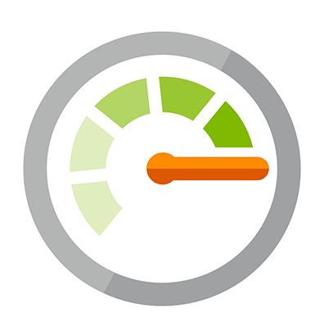














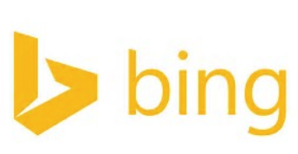














Proven Technology
2015: Production 2019: Generally available 2021: Formally in Synapse
Battle tested for Microsoft internal workload
The platform for analytical solutions (SaaS)
Available as PaaS
Azure Monitor
Security Products
IoT
#PoweredByADX
Notes:
Let me tell you about our journey with Azure Data Explorer.
To meet the growing demand of various Microsoft cloud services, Azure Data Explorer was home grown and launched back in 2015. Internally it’s called Kusto and used widely across Microsoft for telemetry analytics. It’s also the underline warm store for Azure Monitor, Application Insights, Azure Security Center, Time Series Insights, IoT Central, and more. All these services offers “a fit for purpose end to end solution”.
This is the same underline technology that we are offering to you as an Azure PaaS service.
© Microsoft Corporation

Slide 8
Walkthrough Demo – Please follow along!
ADX Web-UI / KE tool
Sample Queries – write it with us!
Notes:
Demo the web-ui https://aka.ms/adx.try how to connect to a cluster show them some sample queries of help cluster, not KDA, ie. StormEvents, etc. Take 10 Time filter Summarize Parse Extend Let operator Getschema , explain commands change per new line | Write it with us!

Slide 9
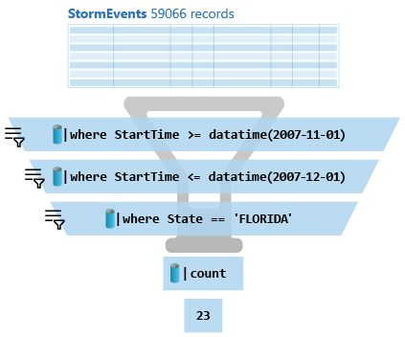
Kusto Query Language (KQL)
A powerful query language to explore data in ADX to find patterns, trends, identify anomalies, perform exploratory and observational analytics.
A Kusto query is a read-only request on data with filters and aggregates that work in a top-down approach
For Example
StormEvents
| where StartTime between (datetime(2007-11-01) .. datetime(2007-12-01))
| where State == "FLORIDA"
| count

Slide 10
KQL Concepts
Relational operators (filters, union, joins, aggregations, …)
Each operator consumes tabular input and produces tabular input
Can be combined with ‘|’ (pipe)
Similarities: OS shell, LINQ, functional SQL…
Query agility, ease to write, read & change.
Statements: Single statement query, ‘let’ for reusing statements, Multi-statement (‘;’) queries

Slide 11
KQL Basic Operators
… | count
Counts records in input table (e.g. T)
… | take 10
Get few records - to familiarize yourself with the data. No actual order ensured.
… | where Timestamp > ago(1) and UserId = 'abdcdef'
Filtering on a specific fields
… | project Col1, Col2, …
Choose some columns (great if input table has dozens of columns)
…| extend NewCol1=Col1+Col2
Introduces new calculated columns
… | render timechart
Render data into a visual plot while exploring.

Slide 12
KQL Resources for your Self-Study
aka.ms/StartKQLVideo (1hr)
Kusto Query Language (KQL) overview
Work through guided learning module: aka.ms/learn.kql (30 min)

Slide 13
Go to inbox
I’m glad to have you on the team. This place sure needs some new blood.
As the newest member of the department, you’re going to have to start small and work your way up the ladder. Click on the button below to get your first case assignment. Hurry up and do your best – rewards await the best new recruits. Be careful, though. Things aren’t always what they seem around here in Digitown.
Good luck, rookie. You’re going to need it.
- The Lieutenant

Slide 14

The Lieutenant: Onboarding
Create a free Kusto cluster at https://aka.ms/kustofree
You’ll need either a Microsoft account (MSA) or an Azure Active Directory (AAD) identity.
Run the provided script and sum up the values in the “Score” column.
Provide your full cluster URL to submit answer and claim your badge.

Slide 15
Onboarding – Tips & Hints ✏️
You can easily print the cluster endpoint using KQL to get the URL quickly...
print current_cluster_endpoint()
The cluster URL + Score is what completes the Onboarding sign-on process.
If your cookies expire, clear browser cache, or switch laptops you will need to do this again to unlock your previous progress.
Notes:
IMPORTANT: If someone solves it, we can invite them to show how they did it themselves.
Or after 20 minutes, proctor start developing the answer live. Explain each step of how to derive the process to the answer.

Slide 16


1st Case: The rarest book is missing!
The director can't locate the rarest book: "De Revolutionibus Magnis Data", published 1613, by Gustav Kustov
Each book has its parameters recorded: number of pages, weight.
Each book has RFID sticker attached (RFID: radio-transmitter with ID).
Each shelve measures actual total weight of books and the RFIDs on the shelve.
Can you locate the missing book on one of the shelves and save the day?
Run the provided script and analyze the data to find the missing book.

Slide 17
1st Case – Tips & Hints ✏️
How can we convert RFIDs are stored to a set of rows? Hint, mv-expand
Since we will be comparing things, how can we build two datasets and compare them using some kind of operators? Hint, the let statement and the join operator.
Can we make a new column that calculates the weight difference? Hint, extend operator.
Notes:
IMPORTANT: If someone solves it, we can invite them to show how they did it themselves.
Or after 20 minutes, proctor start developing the answer live. Explain each step of how to derive the process to the answer.

Slide 18


2nd Case: Election fraud?
The mayor of Digitown, Mrs. Gaia Budskott, is in quite a pickle.
Over 5 million people voted online for the city’s mascot.
The polls predicted between Kastor 🐘 & Gaul 🐙, but the results showed the ex-mayor’s fish (Poppy 🐟) got 51.7% of all votes & sounds fishy…
You have access to the elections data: IP, anonymized id, vote, date-time, and the function used for counting the votes.
Run the provided script to analyze the data and submit the correct election percentage of votes per candidate.

Slide 19
2nd Case – Tips & Hints ✏️
Most important is not to overthink things. Go with your gut feeling. How could votes render fraudulent? Hint, speed, duplicates, etc.
How can we calculate the lightning-fast rapid rate of votes over time? Hint, analyze one device but they all have the problem, see window functions, ie. next() and datetime_diff().
Notes:
After 20 minutes, proctor start developing the answer live. Explain each step of how to derive the process to the answer. If someone solved it, we can invite them to show how.
Or proceed Case 3 if the room chooses. PRIORITY is to continue with KDA.
Alternatively, do QnA and other demos such as Needle in a haystack, Taxi, GH, Thermostats, etc.

Slide 20
Resources
aka.ms/StartKqlVideo
aka.ms/learn.kql
aka.ms/adxinaday
aka.ms/adx.microhack
aka.ms/adx.pluralsight
aka.ms/adx.try
aka.ms/adx.youtube
aka.ms/adx.blog
aka.ms/adx.sof
Notes:
medium.com/@avivyaniv ( SPOILER ALERT! )

Slide 21
Season 2 coming soon!

